Slide 1


Single cell RNA Seq Snap workflow (ScRNASeqSnap)
Antonia (Tonia) Chroni, PhD
Senior Bioinformatics Research Scientist
DNB Bioinformatics Core
December XX, 2024

Slide 2





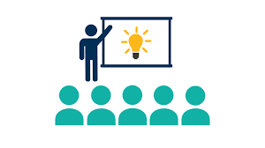

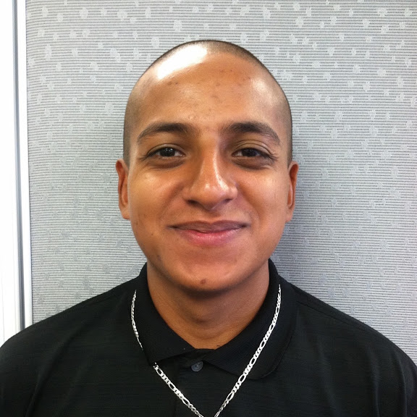
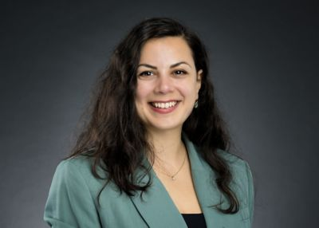
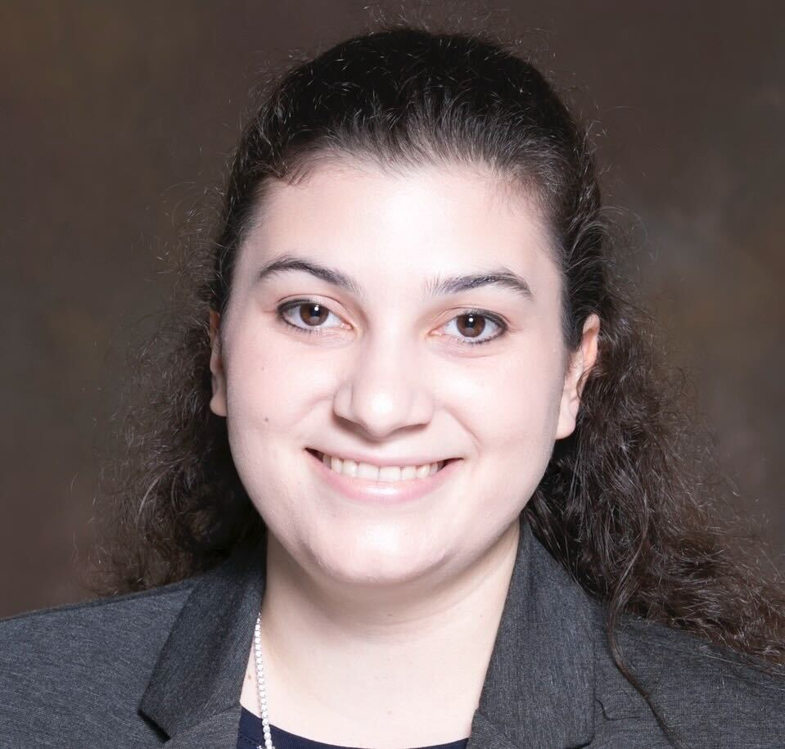
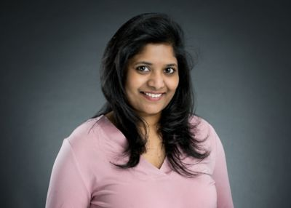
Bioinformatics core, Department of Developmental Neurobiology
Providing advanced bioinformatic services for investigators to leverage omics data
Project analysis & Benchmarking
Consultation
Training
Innovation
Cody Alexander Ramirez, PhD
Senior Bioinformatics Research Scientist
Core Director
Boston, Massachusetts
Antonia Chroni, PhD
Senior Bioinformatics Research Scientist
New York, New York
Sharon Freshour, PhD
Bioinformatics Research Scientist
St. Louis, Missouri
Asha Jacob Jannu, PhD
Bioinformatics Research Scientist
Indianapolis, Indiana
Notes:
All the material can be found at our GitHub under the ‘Trainings’ repository.

Slide 3
Code of Conduct
No child is denied treatment based on race, religion, or a family's ability to pay.
Advance cures and prevention for pediatric catastrophic diseases through research and treatment.
Be respectful and graceful
Gracefully accept constructive criticism.
Focus on what is best for the community.
Welcoming and inclusive
Value and respect everyone’s viewpoints and experiences.
Use welcoming and inclusive language.
Share groundbreaking discoveries and research.
Show courtesy and respect towards other community members.
Be kind
and
have fun
We welcome everyone in the research community.
We are committed to creating a friendly and respectful place for learning, teaching, and contributing.
Notes:
Our mission is to improve the survival rates of children with cancer and other catastrophic diseases, worldwide,
through the sharing of knowledge, technology and organizational skills. Our vision is that every child diagnosed with cancer or another catastrophic disease has access to quality care and treatment.
Appropriate behavior includes but is not limited to:

Slide 4
Learning Objectives
fastqc-analysis
cellranger-analysis
….

Slide 5
Best practices for reproducibility 🎉
Make an outline
What is the snap pipeline
Where it is available, how to download, how to uset he container
Code review process: test-dataset – validation phase will follow with human and pdx experiment
What do I want o show them during the workshop? Modules, scope of module, method(s), results, plots, reports: how do these looks like
Notes:
In software development, and specifically, in the context of cancer informatics, we deal with very complex projects that often utilize multiple omics data which in turn need sophisticated algorithms and pipelines for data analysis and interpretation.
Good documentation helps users understand how to use software tools, datasets, and workflows. It facilitates reproducibility and enables collaboration among researchers.
Automating repetitive tasks can save time and reduce human error.
Containers allow for versioning and accessibility, and keep updated software versions.

Slide 6
….
….
Notes:
My personal journey with reproducibility and appreciating its great power has been started and challenged

Slide 7
More resources 🎉
…..

Slide 8


Slide 9

Ask me questions 😀
..
Tonia
Antonia Chroni, PhD
she/her/hers
Senior Bioinformatics Research Scientist
New York, New York
@AntoniaChroni

